Slide 1

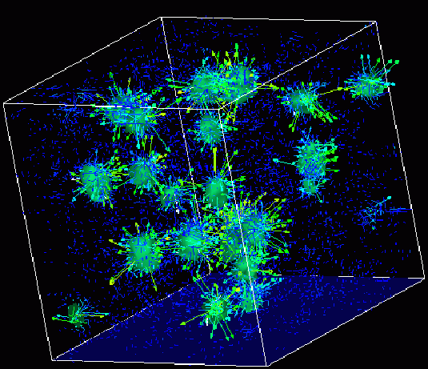

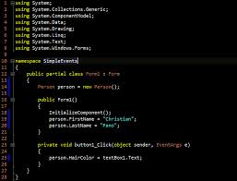
Advanced
Scientific Computing
(SciComp 201)
Session 08
Least Squares Curve Fitting

Slide 2
Session Goals
Use the “Method of Least Squares” to fit a quadratic curve to a set of observations to interpolate resulting values that lie between the observations
Derive the least squares equations using the partial derivatives for each coefficient of the unknown quadratic
Using Cramer’s Rule, solve the resulting 3 x 3 system of linear equations derived from the sigmas
Appreciate % relative error as a measure of “goodness of fit” of a model to experimental data

Slide 3
Method of Least Squares
Developed by Gauss, least squares finds the coefficients of a polynomial of a given degree that approximates a set of observations with minimal variance from the data
The modeler selects a curve whose general shape matches the trend of the data
This case study will use data from an experiment that measured the counter on a tape machine vs. the elapsed time the tape had been played
Ideally this would be a linear relationship – but due to the changing circumference of a tape reel as it is played, the drive motor does not maintain consistent timing, so it is non-linear

Slide 4
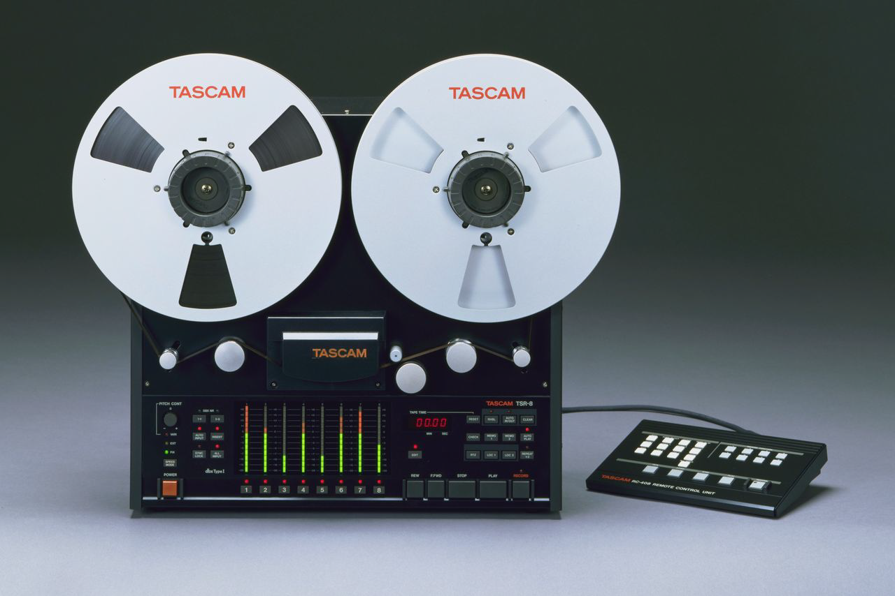
Method of Least Squares
Find an equation to model a tape counter as a function of playing time.
X value is the number of 10 minute blocks the tape has been playing from the beginning
Y value is the counter on the tape player (linear feet)
With a good fitting model we can answer questions like: Where should I stop the tape to be exactly 65 minutes into the recording?

Slide 5
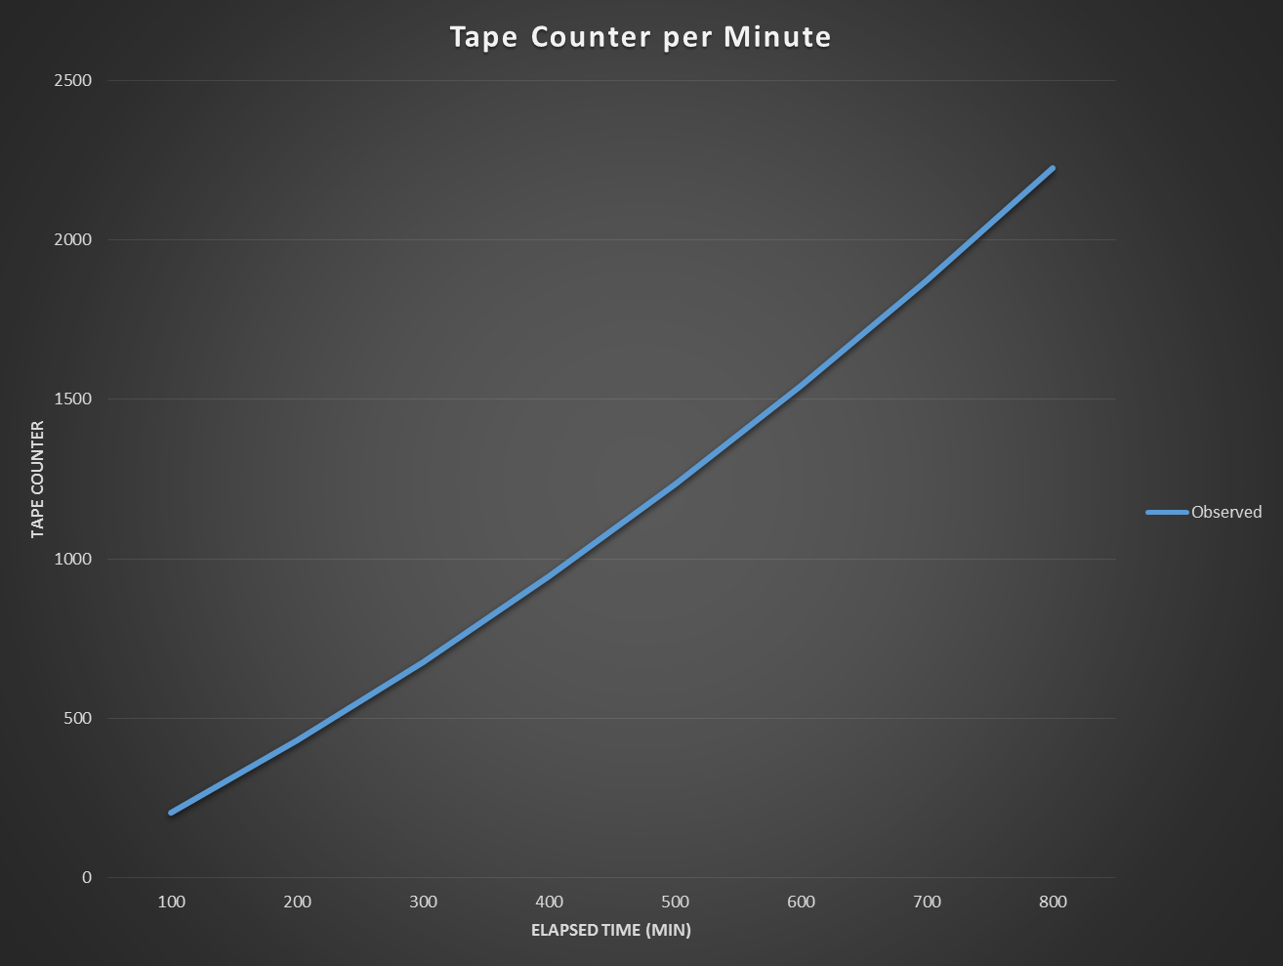
Method of Least Squares
$$Assume$$
$$y=ax^{2}+bx+c$$

Slide 6
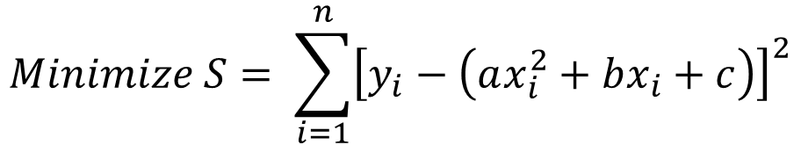

Method of Least Squares
$$Minimize S= \sum_{i=1}^{n}{{\left[y_{i}−\left(ax_{i}^{2}+bx_{i}+c\right)\right]}^{2}}$$
$$\left(y−{ax}^{2}−bx−c\right)\left(y−{ax}^{2}−bx−c\right)$$
$$y^{2}−ax^{2}y−bxy−cy$$
$$−ax^{2}y +a^{2}x^{4}+abx^{3}+acx^{2}$$
$$−bxy +abx^{3} +b^{2}x^{2}+bcx$$
$$−cy +acx^{2} +bcx+c^{2}$$
$$S=y^{2}−2ax^{2}y−2bxy−2cy+a^{2}x^{4}+2abx^{3}+2acx^{2}+b^{2}x^{2}+2bcx+c^{2}$$

Slide 7
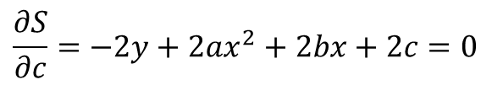
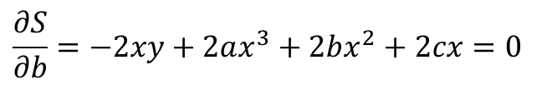
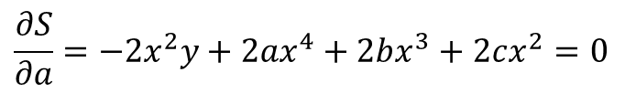

Method of Least Squares
$$Minimize S= \sum_{i=1}^{n}{{\left[y_{i}−\left(ax_{i}^{2}+bx_{i}+c\right)\right]}^{2}}$$
$$S=y^{2}−2ax^{2}y−2bxy−2cy+a^{2}x^{4}+2abx^{3}+2acx^{2}+b^{2}x^{2}+2bcx+c^{2}$$
For S to have a minimum, these partial derivatives must exist:
$$\frac{∂S}{∂a}=0,\frac{∂S}{∂b}=0,\frac{∂S}{∂c}=0$$
$$\frac{∂S}{∂a}=−2x^{2}y+2ax^{4}+2bx^{3}+2cx^{2}=0$$
$$\frac{∂S}{∂b}=−2xy+2ax^{3}+2bx^{2}+2cx=0$$
$$\frac{∂S}{∂c}=−2y+2ax^{2}+2bx+2c=0$$

Slide 8

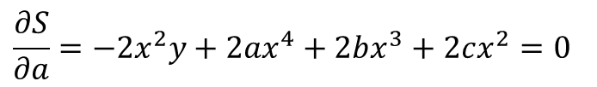


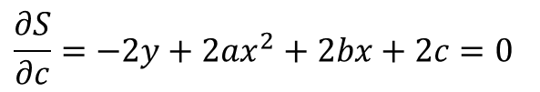
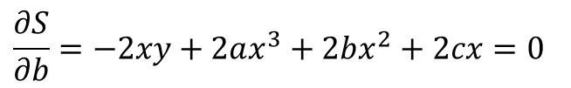
Method of Least Squares
$$Minimize S= \sum_{i=1}^{n}{{\left[y_{i}−\left(ax_{i}^{2}+bx_{i}+c\right)\right]}^{2}}$$
$$\frac{∂S}{∂a}=−2x^{2}y+2ax^{4}+2bx^{3}+2cx^{2}=0$$
$$\left(x^{4}\right)a+\left(x^{3}\right)b+\left(x^{2}\right)c=x^{2}y$$
$$\frac{∂S}{∂b}=−2xy+2ax^{3}+2bx^{2}+2cx=0$$
$$\left(x^{3}\right)a+\left(x^{2}\right)b+\left(x\right)c=xy$$
$$\frac{∂S}{∂c}=−2y+2ax^{2}+2bx+2c=0$$
$$\left(x^{2}\right)a+\left(x\right)b+c=y$$

Slide 9
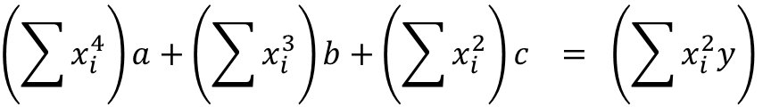
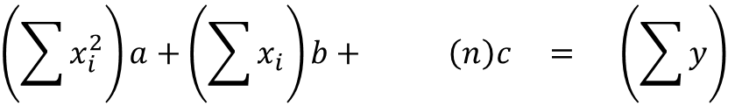
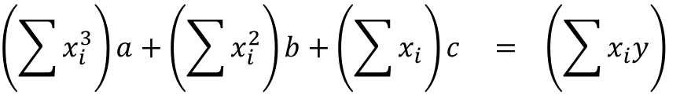
Method of Least Squares
$$Minimize S= \sum_{i=1}^{n}{{\left[y_{i}−\left(ax_{i}^{2}+bx_{i}+c\right)\right]}^{2}}$$
$$\left(\sum{x_{i}^{4}}\right)a+\left(\sum{x_{i}^{3}}\right)b+\left(\sum{x_{i}^{2}}\right)c = \left(\sum{x_{i}^{2}y}\right)$$
$$\left(\sum{x_{i}^{3}}\right)a+\left(\sum{x_{i}^{2}}\right)b+\left(\sum{x_{i}}\right)c = \left(\sum{x_{i}y}\right)$$
$$\left(\sum{x_{i}^{2}}\right)a+\left(\sum{x_{i}}\right)b+ \left(n\right)c = \left(\sum{y}\right)$$

Slide 10
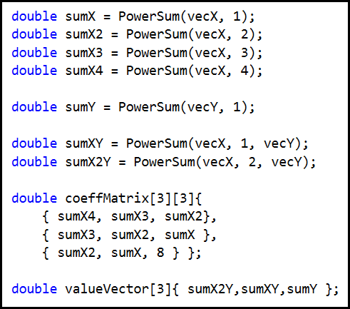
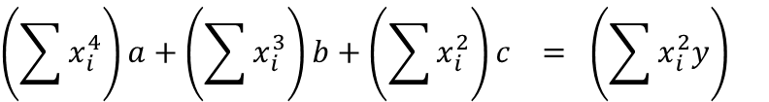
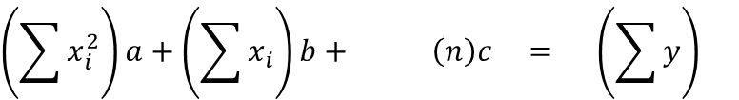
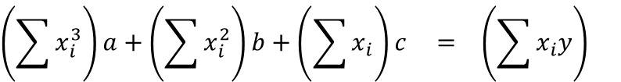
Method of Least Squares – Lab 1
$$Minimize S= \sum_{i=1}^{n}{{\left[y_{i}−\left(ax_{i}^{2}+bx_{i}+c\right)\right]}^{2}}$$
$$\left(\sum{x_{i}^{4}}\right)a+\left(\sum{x_{i}^{3}}\right)b+\left(\sum{x_{i}^{2}}\right)c = \left(\sum{x_{i}^{2}y}\right)$$
$$\left(\sum{x_{i}^{3}}\right)a+\left(\sum{x_{i}^{2}}\right)b+\left(\sum{x_{i}}\right)c = \left(\sum{x_{i}y}\right)$$
$$\left(\sum{x_{i}^{2}}\right)a+\left(\sum{x_{i}}\right)b+ \left(n\right)c = \left(\sum{y}\right)$$

Slide 11
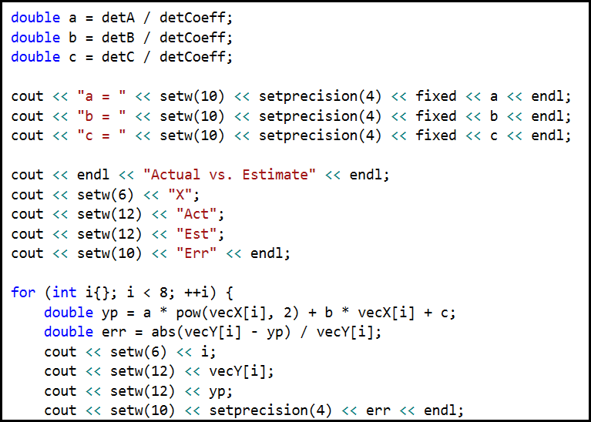
Method of Least Squares – Lab 1

Slide 12
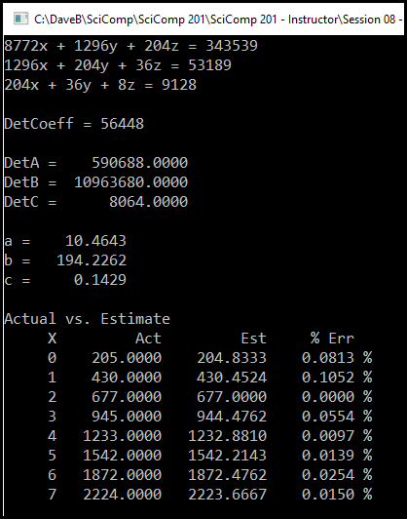
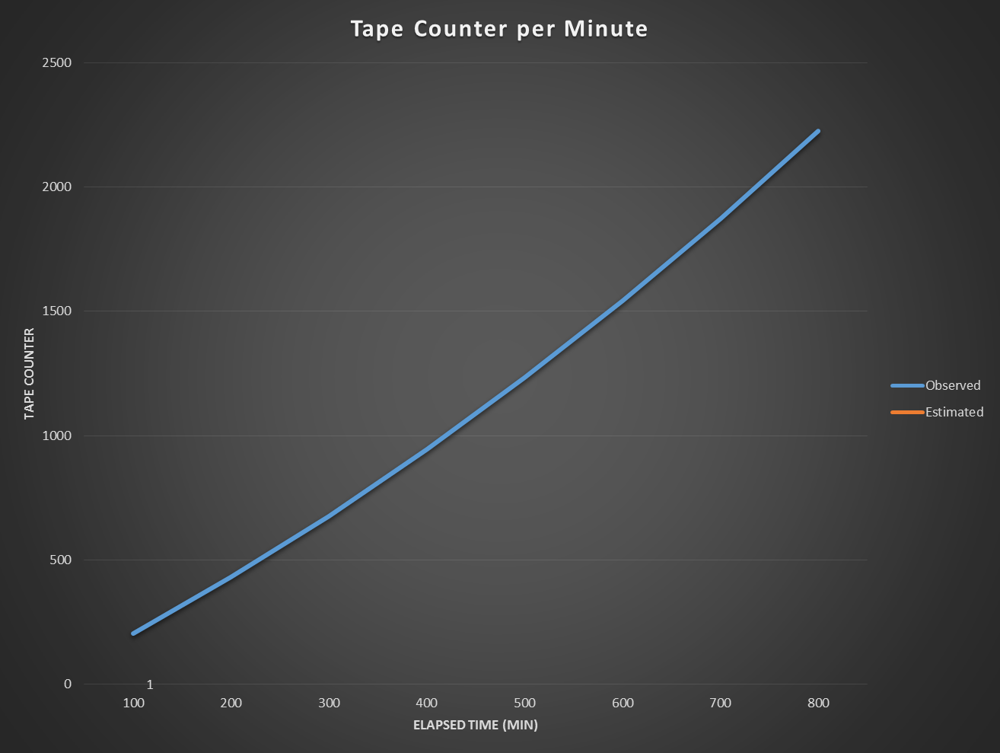
Method of Least Squares – Lab 1
$$y=10.4643x^{2}+194.2262x+0.1429$$

Slide 13
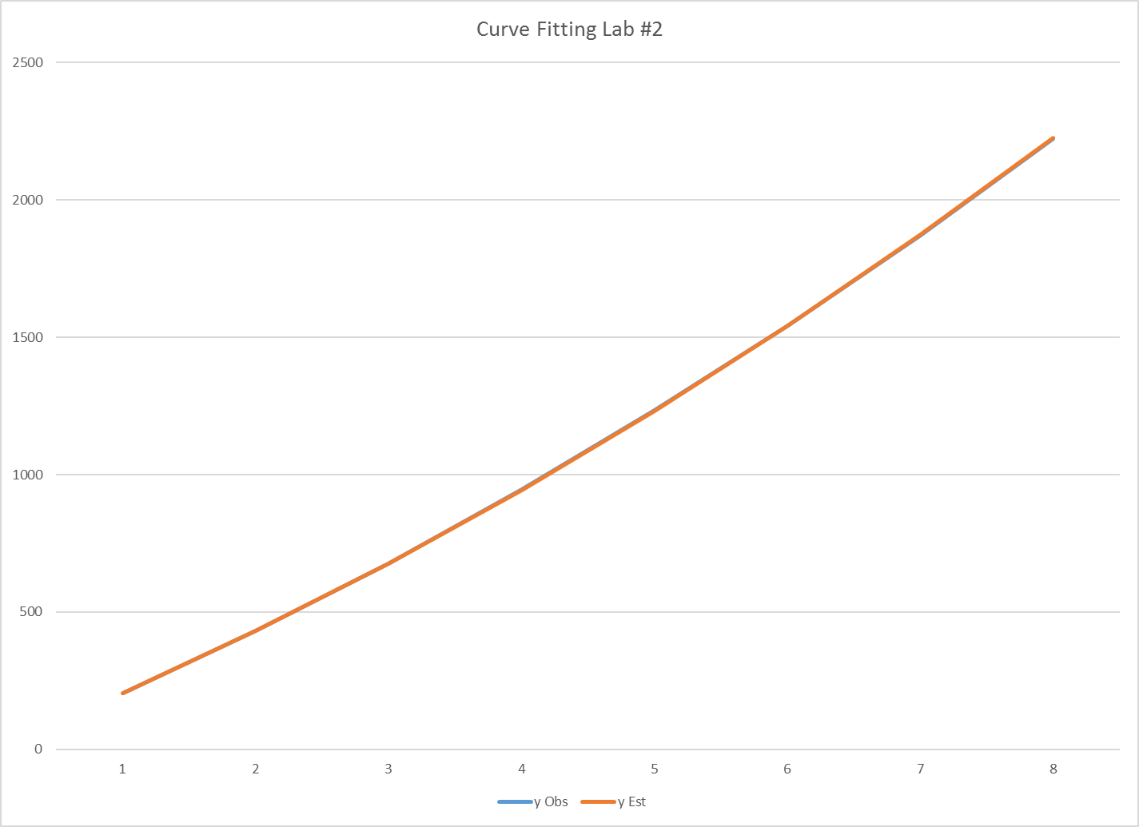
$$y=10.4643x^{2}+194.2262x+0.1429$$
1704
Where should I stop the tape to be exactly 65 minutes into the recording?
$$10.4643{\left(6.5\right)}^{2}+194.2262\left(6.5\right)+0.1429=1704$$

Slide 14
Now you know…
Model fitting starts by assuming the degree of an appropriate curve that reasonably matches the data
The “Method of Least Squares” refers to shaping the approximating curve to minimize the total deviations between the observed data and points on that curve
The function to minimize must be expanded, and then partial derivatives must be found for each coefficient of the approximating curve
The % relative error measures the “goodness of fit” of a model to experimental observations

